Slide 1
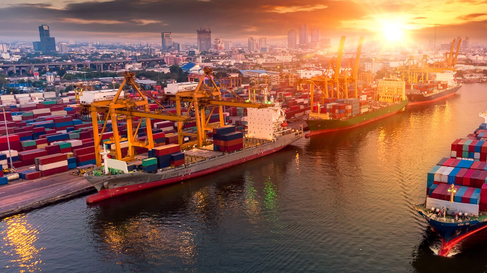
SINGAPORE GLOBAL HUB PORT

Slide 2
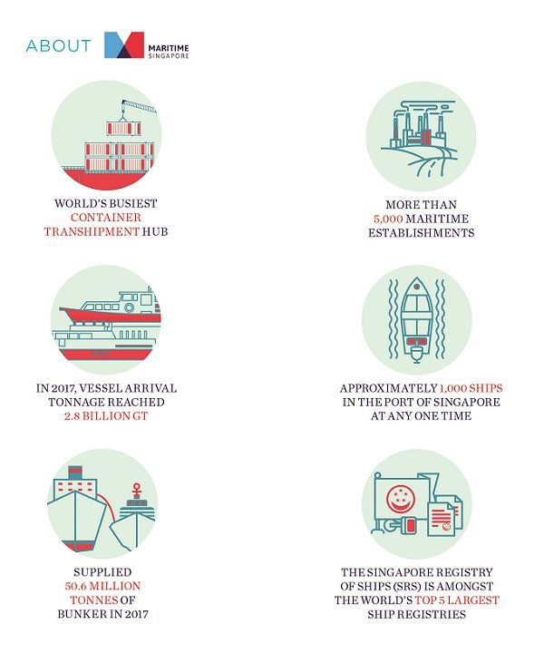
Background
Singapore was the first country in Southeast Asia with a container port, which has since grown to become one of the busiest and most connected in the world, with links to more than 600 ports across 120 countries worldwide.
Annually, more than 130,000 ships call at Singapore.

Slide 3
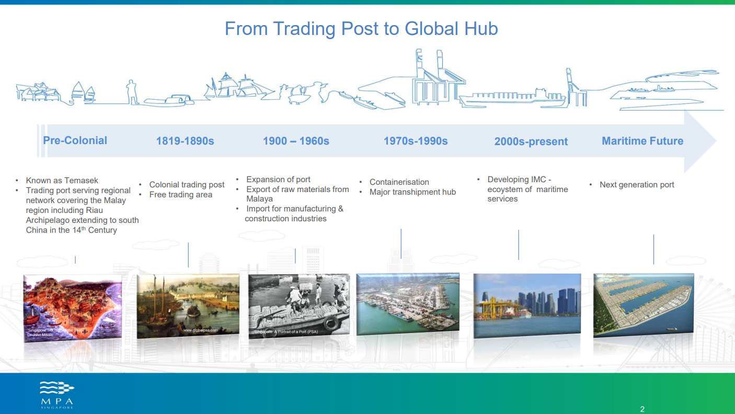

Slide 4
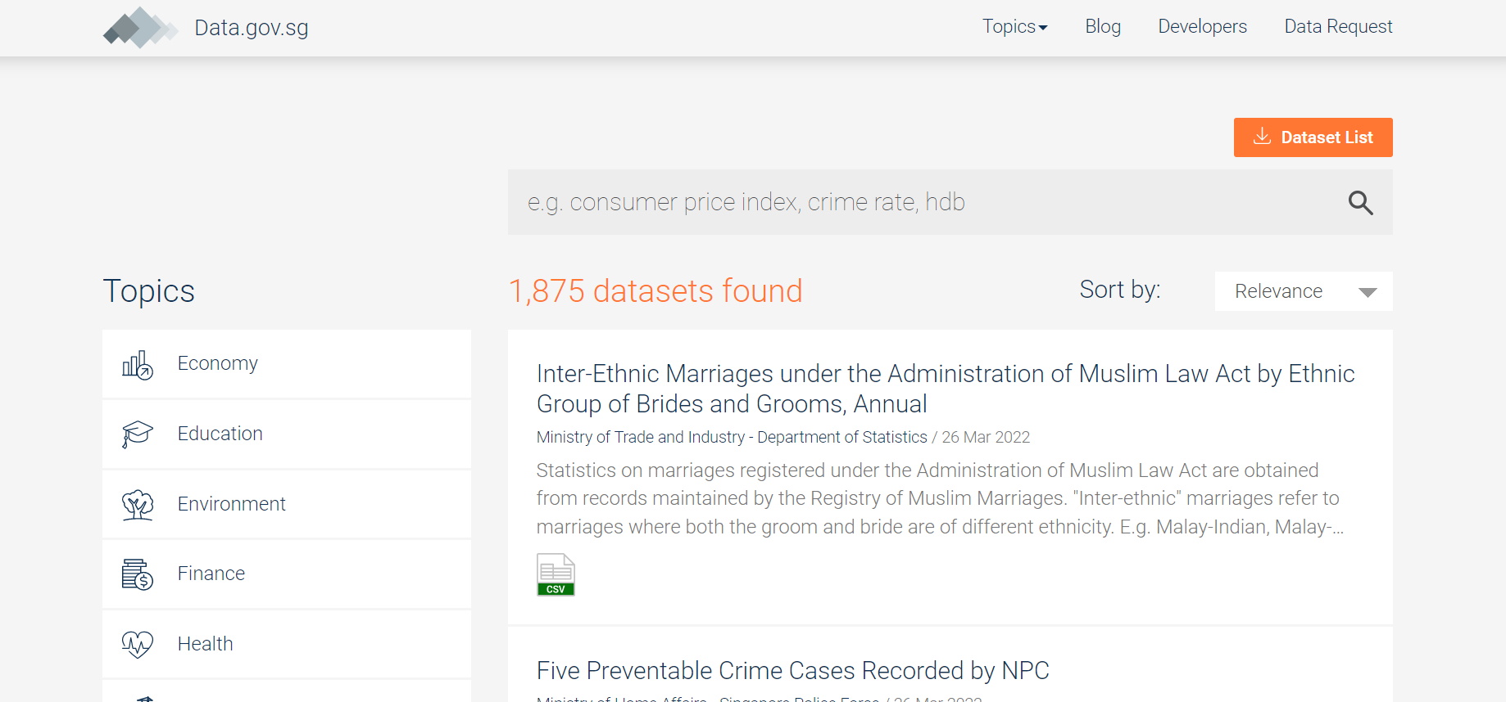
SOURCE OF DATA
Take from:
https://data.gov.sg/search

Slide 5
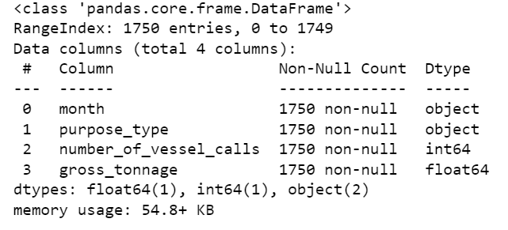
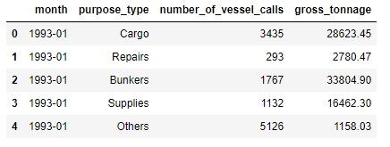
Vessel Calls (>75 GT), Monthly
Numerical data
Categorical data
Reference from:
https://data.gov.sg/search
https://www.google.com/search?q=vessel-calls-75-gt-monthly&oq=VESSEL&aqs=chrome.2.69i59l3j69i57j0i67j69i60l3.5198j0j7&sourceid=chrome&ie=UTF-8

Slide 6
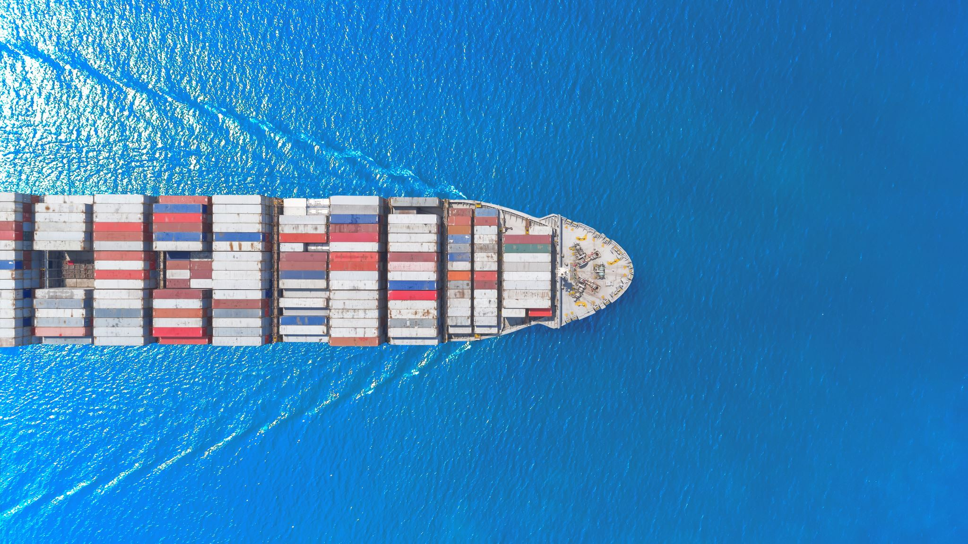
Action
Use clustering method to group the continuous data in clusters
Observe and compare with categorical data
Technique
K Means clustering
Goal
Increase the operation efficiency and provide better services

Slide 7
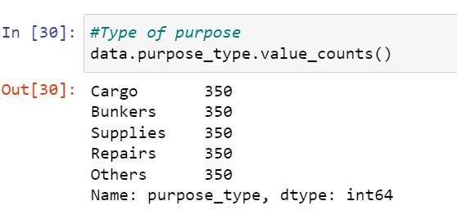
Choosing of K value
Purpose of entering Port | Purpose of entering Port
1 | Cargo | Loading / Discharging of Cargo
2 | Bunkers | Taking Bunkers
3 | Supplies | Taking Ship's Supplies
4 | Repairs | Repair
5 | Others | -Embarking/ Disembarking Passengers -Changing Members of Crew -Offshore Support Vessel Without Cargo Operations

Slide 8
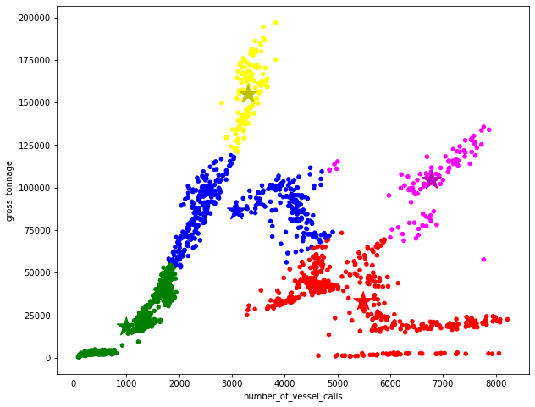

Slide 9
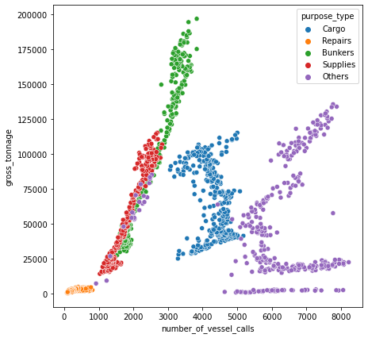
e
K Mean Clustering
Actual data
Action:
We group the data by the gross tonnage(size) and number vessel(demands)

Slide 10

What can we do next?
Explore the data by month, by year?
Explore other unsupervised methods, DBSCAN?

Slide 11
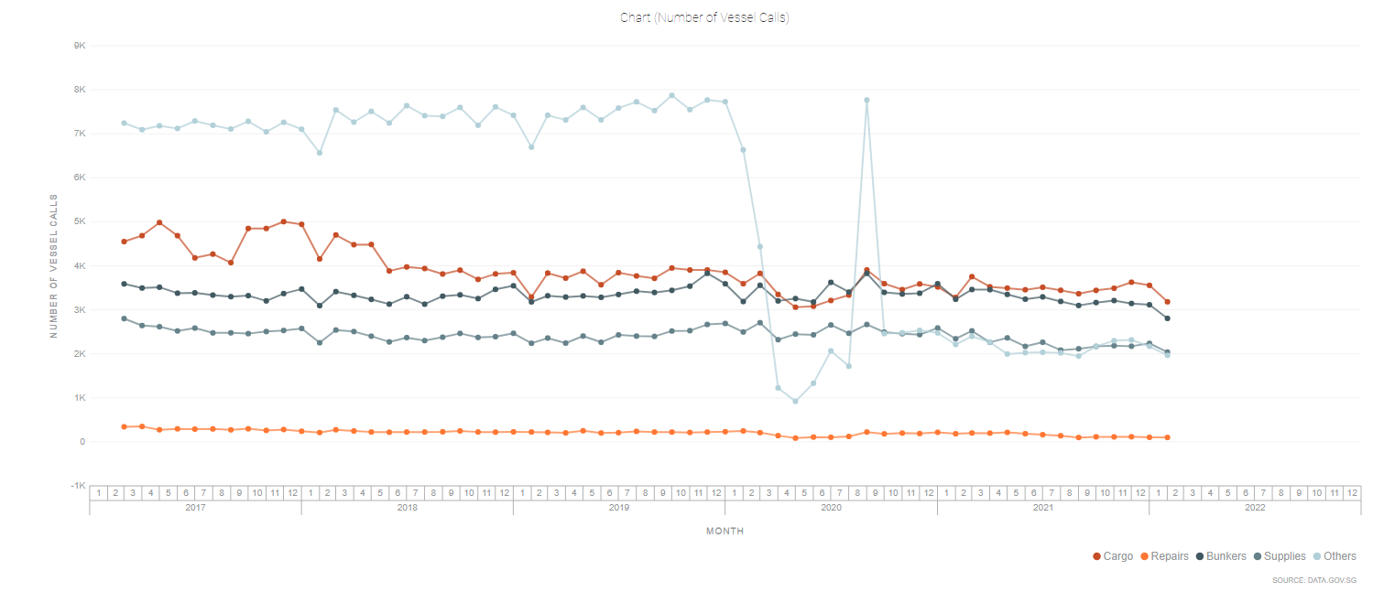
Action: Narrow down the range

Slide 12
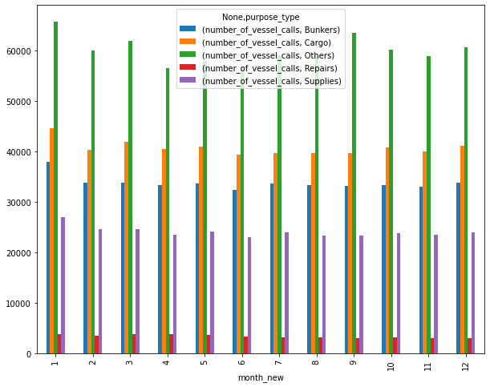
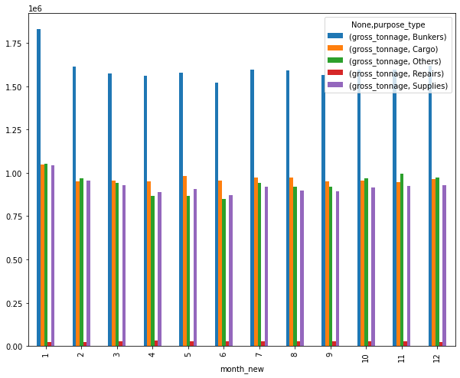
Recent 10 yrs

Slide 13
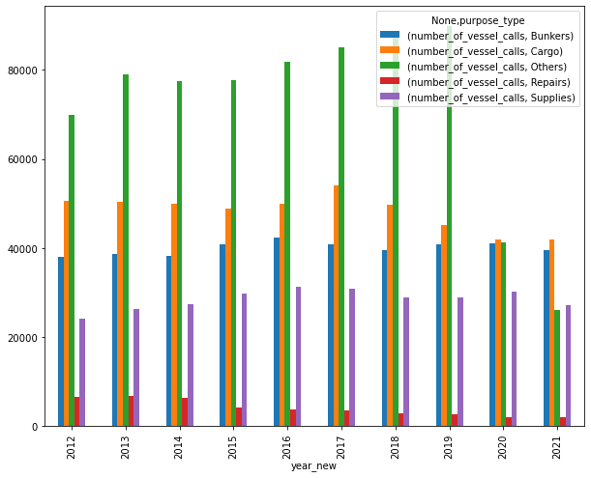
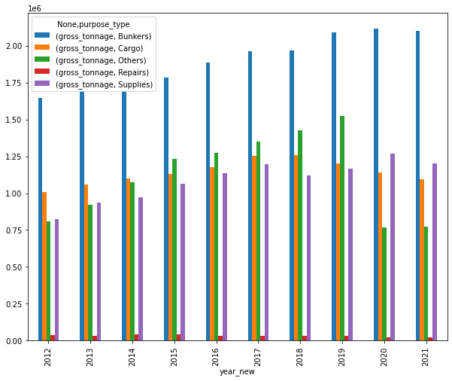

Slide 14
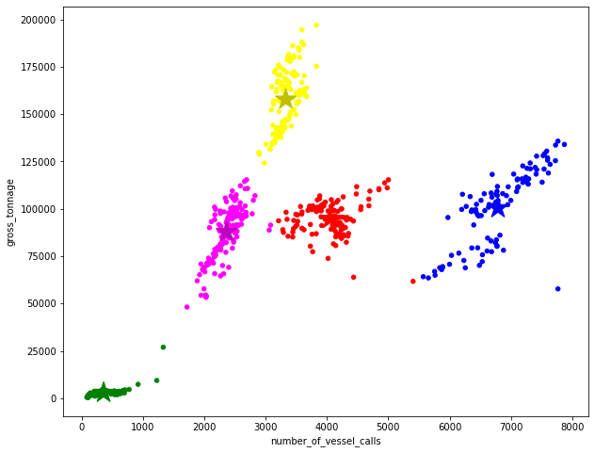
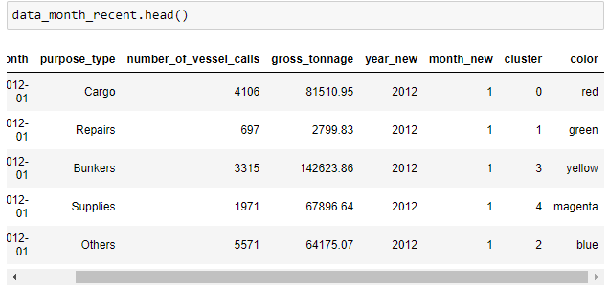

Slide 15
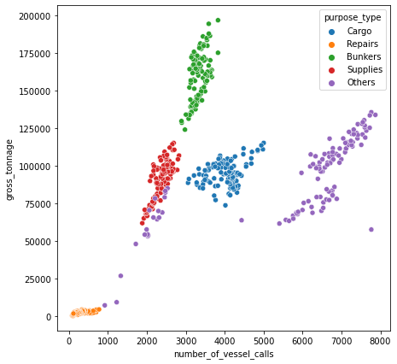
e
bunker
cargo
others
supplies
Repairs

Slide 16
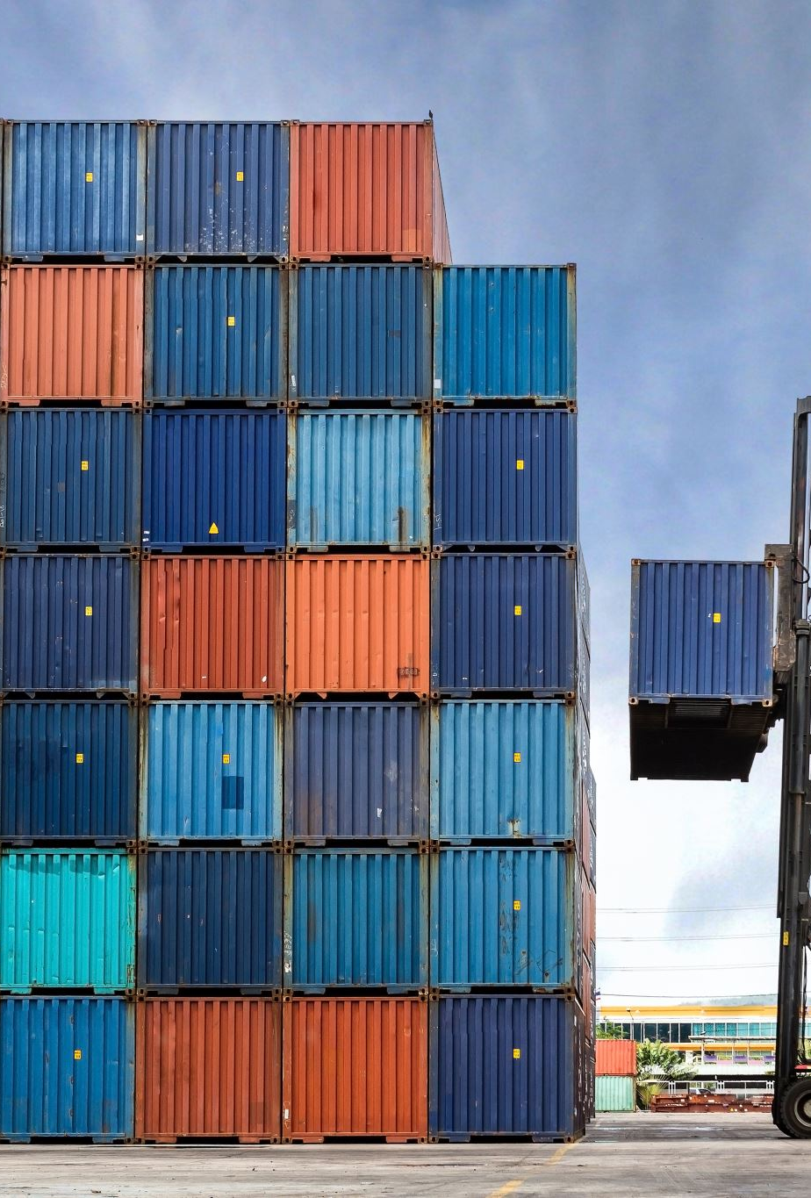
Conclusion
By grouping according to size and demands,
Better port operation -> increase the productivity
Provide efficient service the stakeholders
Manage resources and facility (crane operation, guided vehicles, space else)
Future landscape planning
Provided adequate capacity to meet the demands

